Slide 1

Upload of MED&BS and FDI data
Database testing:
1st Training
17th September 2024
W. Zupa, I. Bitetto

Slide 2
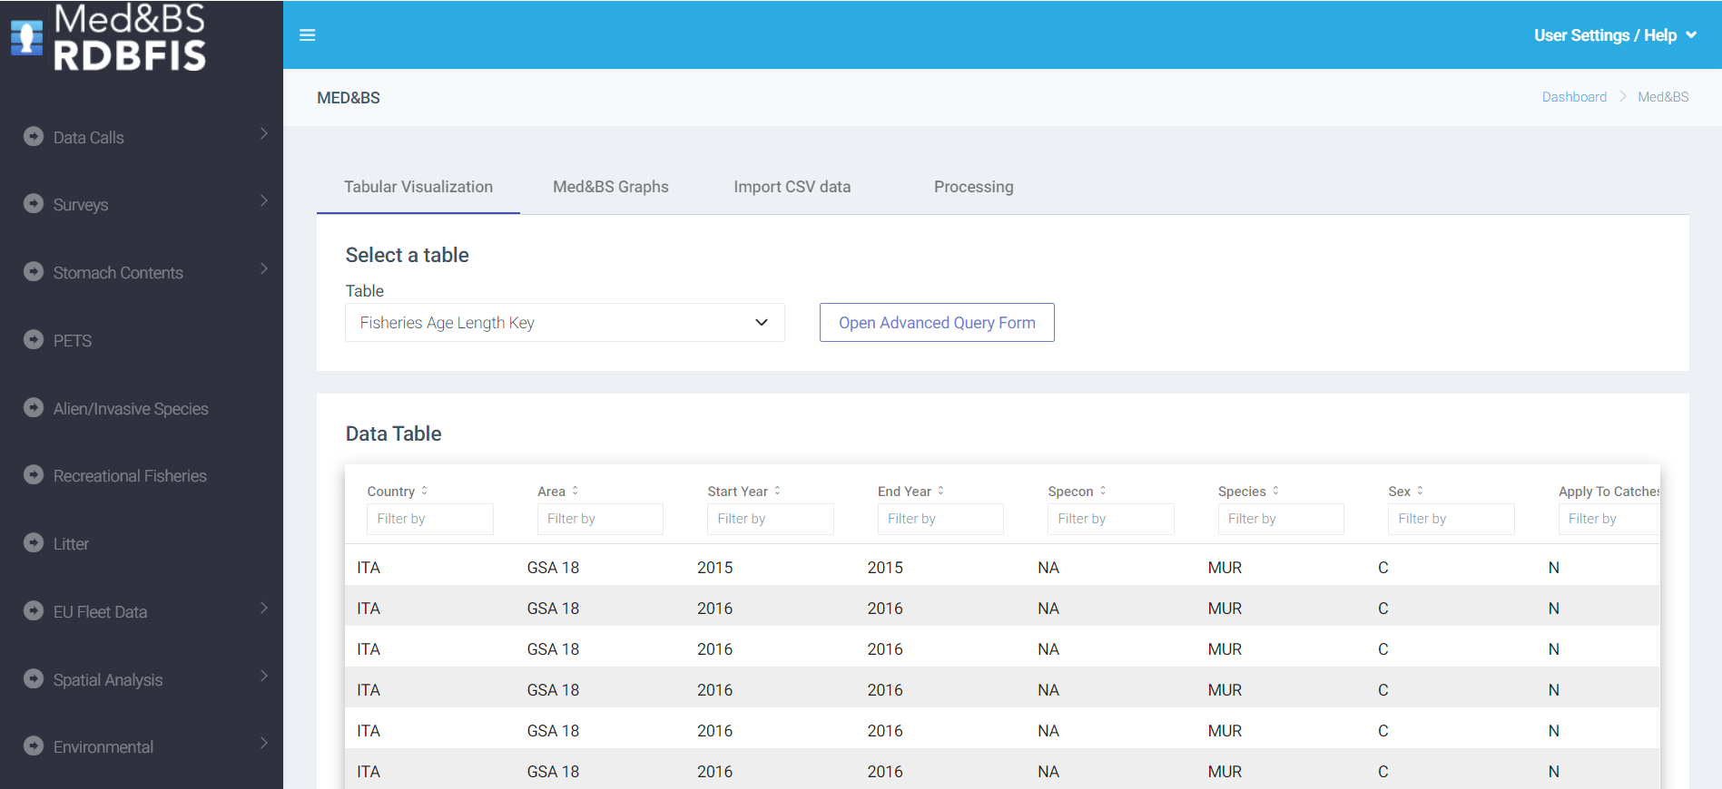
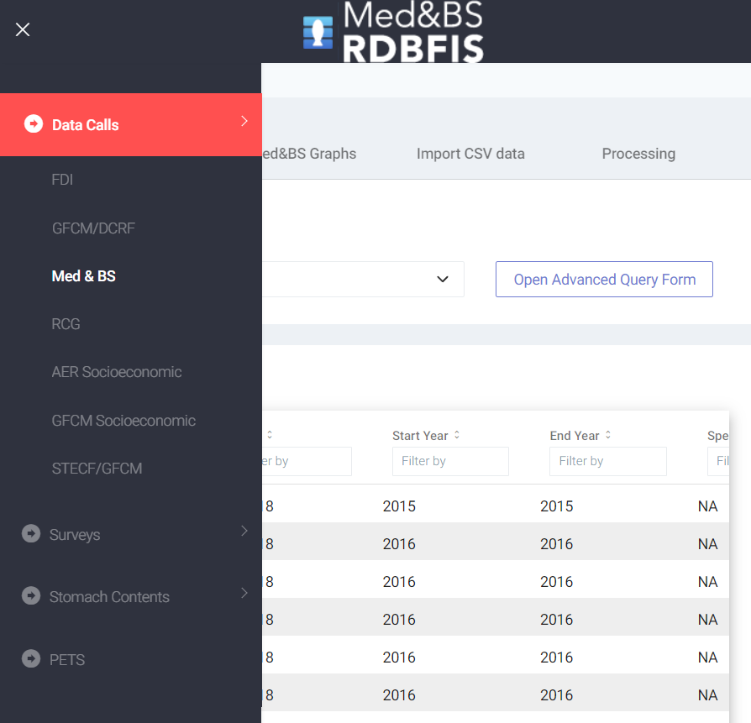

Slide 3
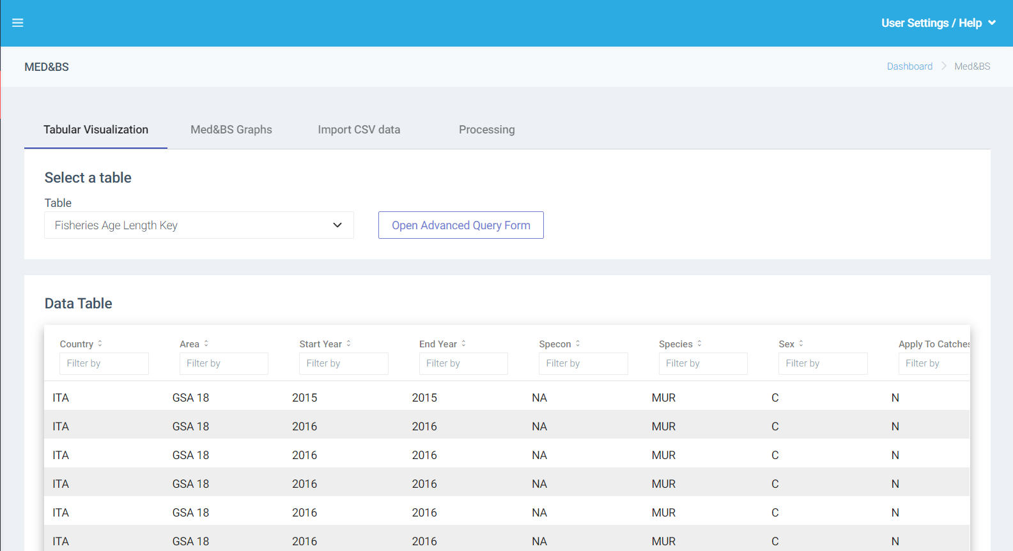
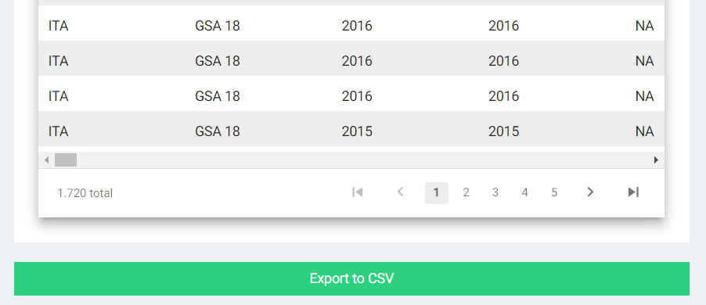
To download data with the expected structure for data import

Slide 4
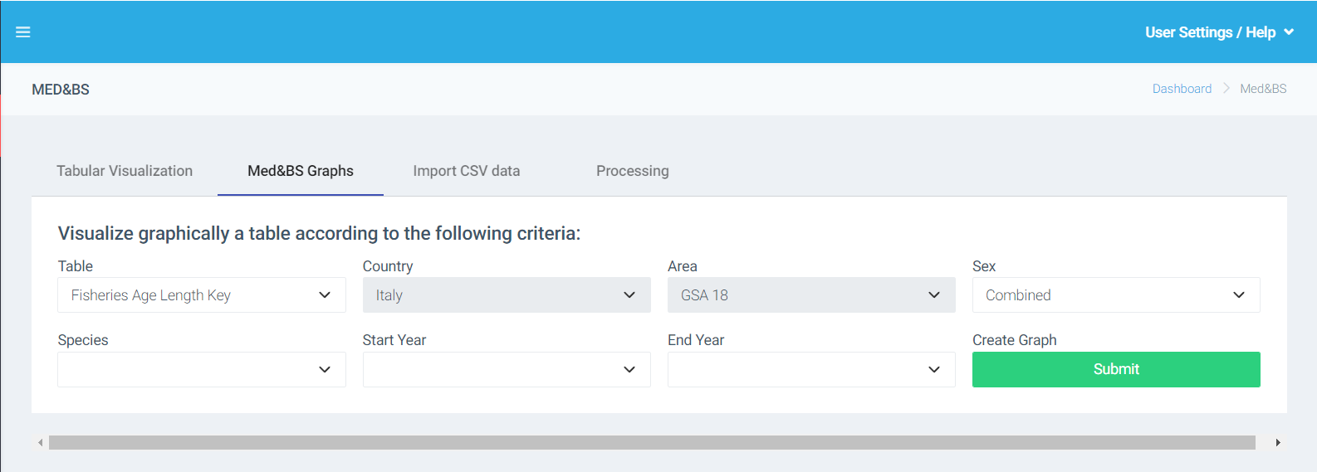

Slide 5
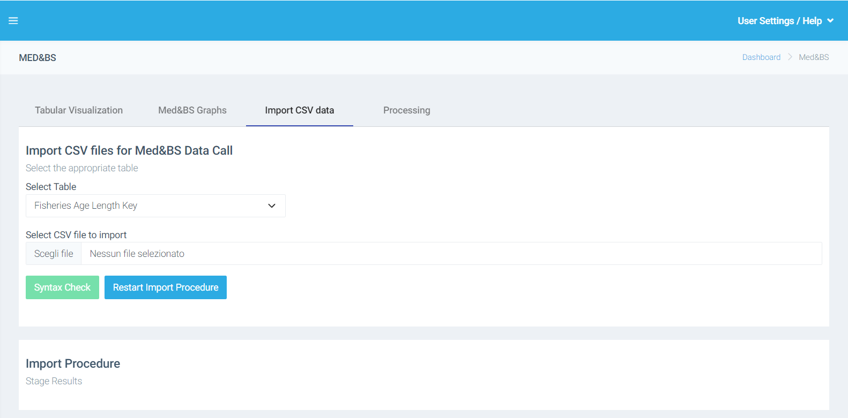

Slide 6
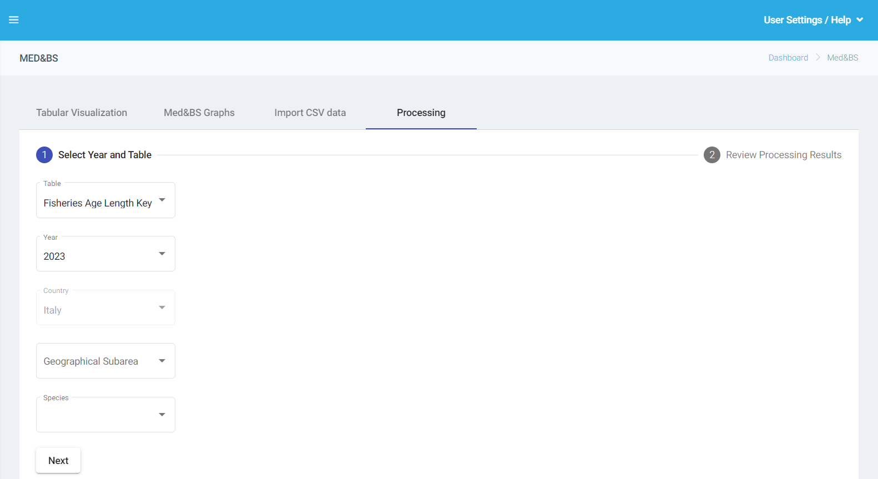

Slide 7
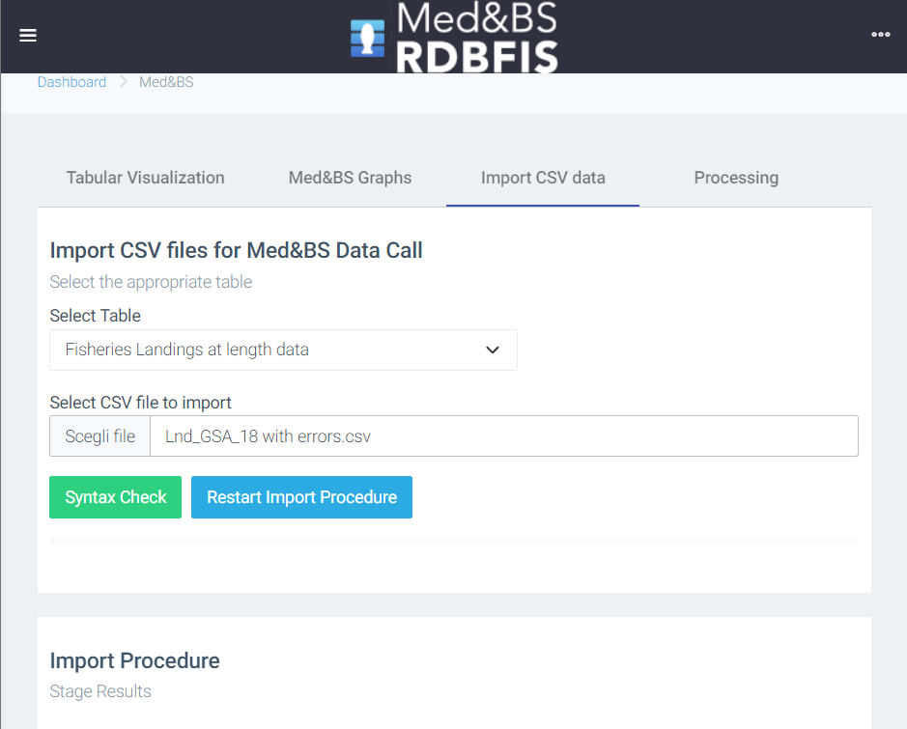
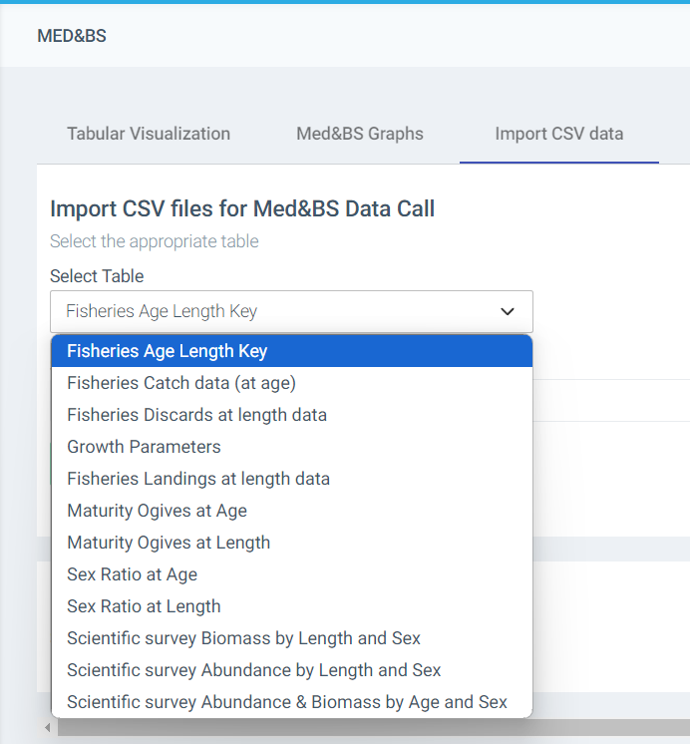

Data import
Data table not consistent with expected data
Error: Metadata header, cannot find the column headers - year, sex, cv, fishery, total_number_of_hard_structure_read_by_age, end_year, apply_to_catches_file, comments, mesh_size_range, vessel_length, quarter, age, gear, id, start_year, landings - .

Slide 8
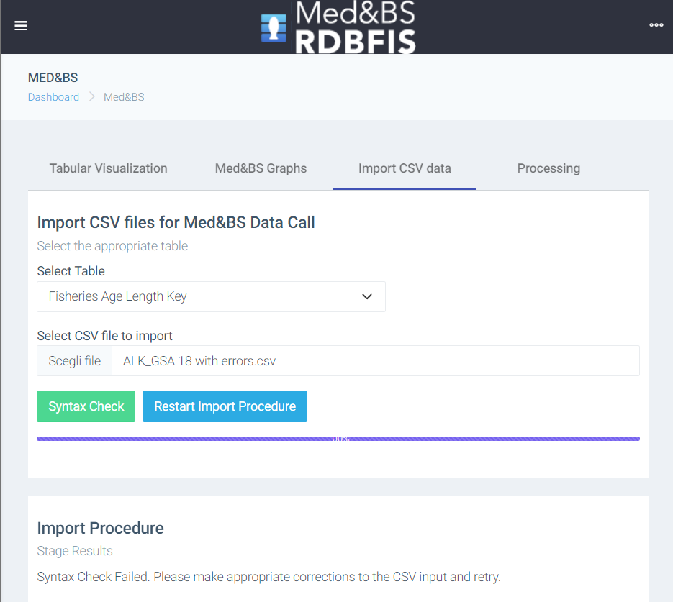
Syntax error
Error: any("F", "M", "C") fails for line: 40, column: sex, value: "R“
Error: unique( $country, $area, $start_year, $end_year, $specon, $species, $sex, $age ) fails for line: 46, column: age, value: "0" (original at line: 45)
Duplicated record

Slide 9
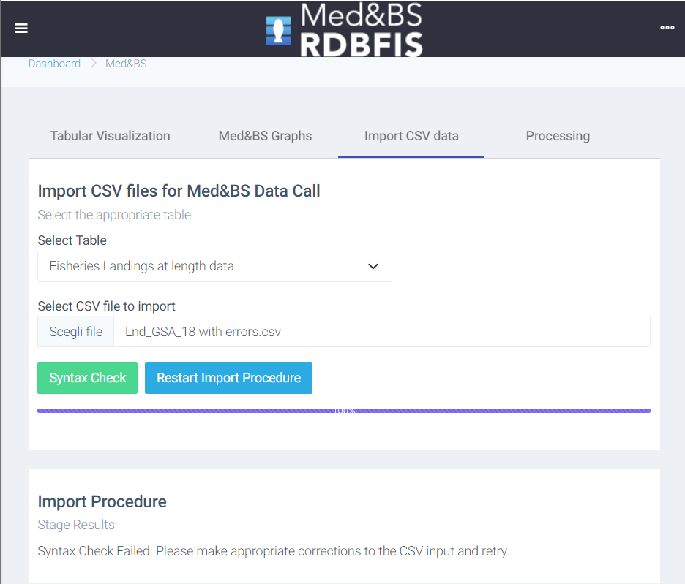
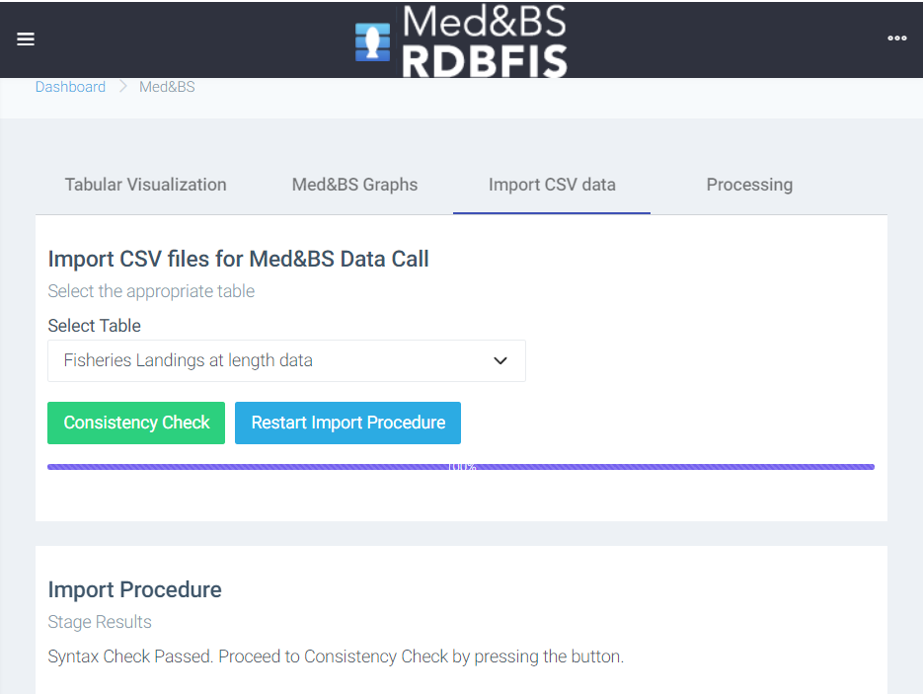
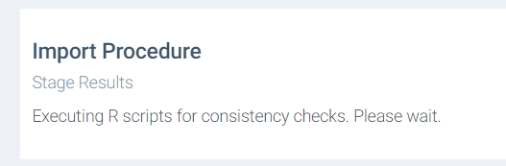
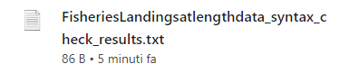

Slide 10
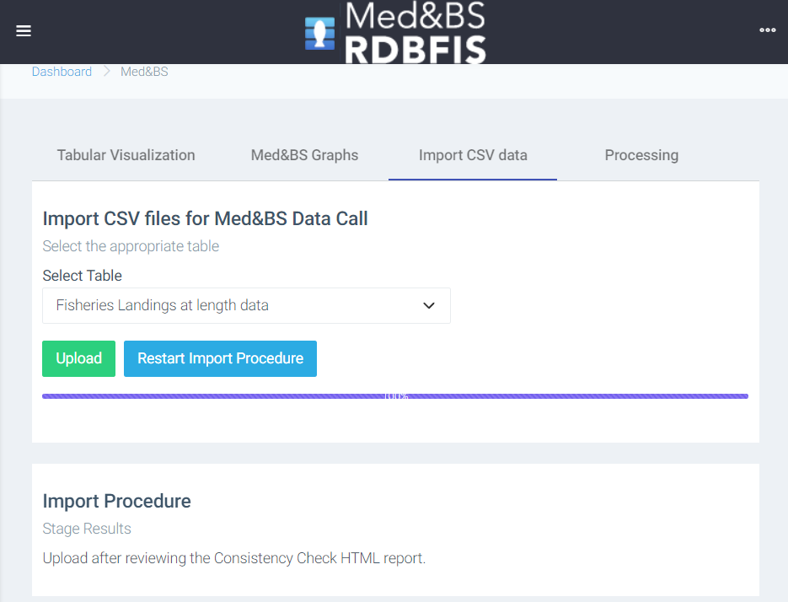
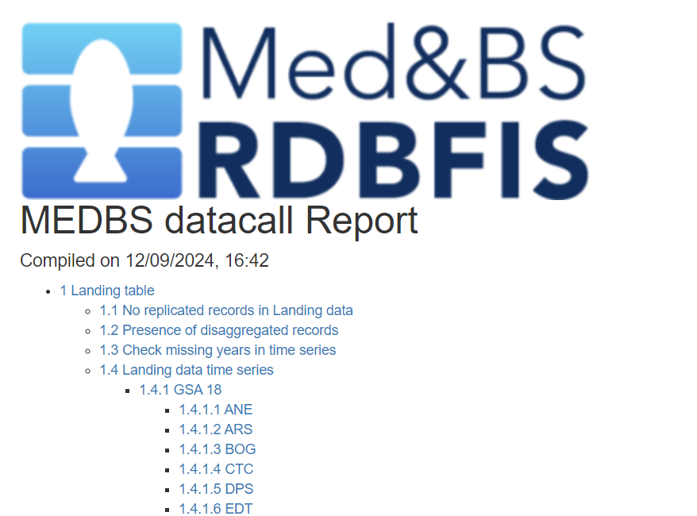


Slide 11
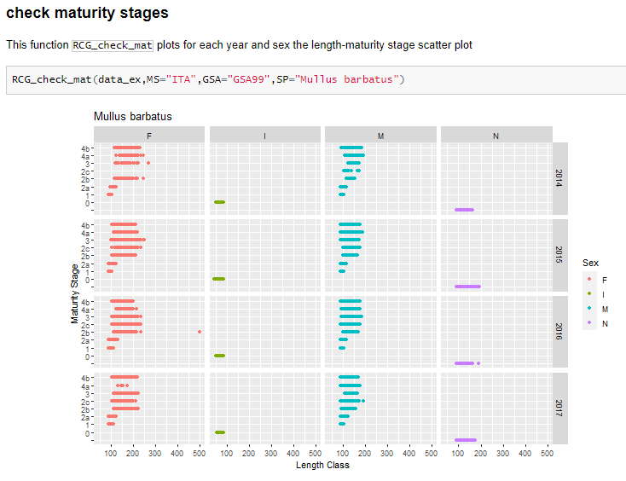



Structure of the RDBqc package
~ 109 functions included in the package
Dummy datasets included to run executable examples
Readme file and vignettes to support users in the use of functions included in the package
Functions’ documentation is embedded in the package
Updated version of the software is publically available can be downloaded from a GitHub repository
https://github.com/COISPA/RDBqc

Slide 12
Data validation and quality checking tools implemented in RDBqc
Supported data call formats:
Med&BS datacall (https://datacollection.jrc.ec.europa.eu/dc/medbs);
FDI datacall (https://datacollection.jrc.ec.europa.eu/dc/fdi );
GFCM DCRF data call (http://www.fao.org/gfcm/data/dcrf/platform/en/);
RCG (https://datacollection.jrc.ec.europa.eu/bg_BG/docs/rcg)
Cross-checks among data calls (developed in QualiTrain project)
For each table and data call:
Syntactic and conformity checks;
Data consistency quality checks.

Slide 13
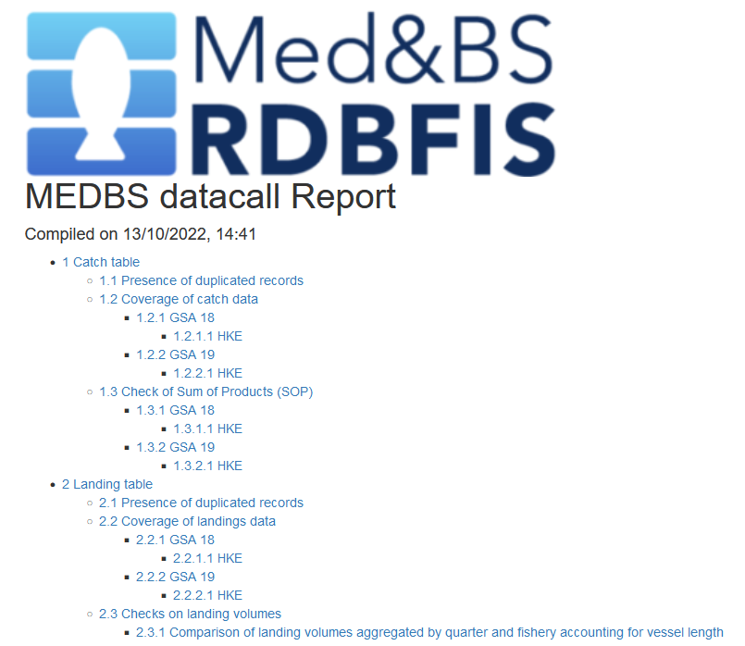

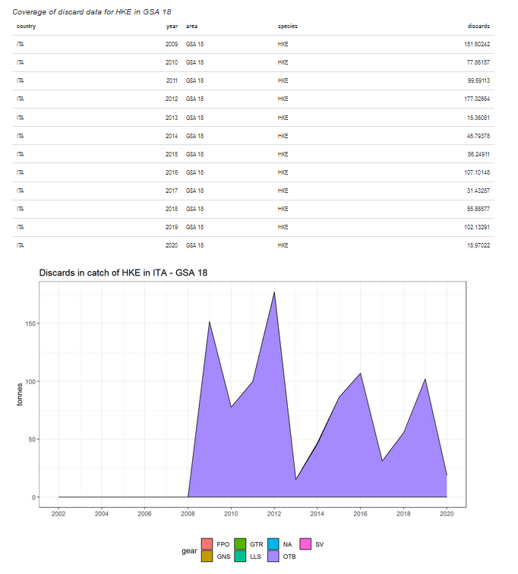
RDBqc functions were organized in a structured way in R Markdown documents to generate automatic reports
R Markdown files characteristics:
Are able to work:
on a single table
on a group of tables
creation of a table of contents with direct hyperlinks to reach the selected section of the report
automatic detection / user definition of the reference Member State, areas and species on which to perform the analysis
Use all QC functions included in the RDBqc R package, generating summary tables and plots useful to check data quality

